Slide 1
“Reach to the Top” Button Project
By Sam Kyataka

Slide 2
What is the “Reach to the Top” club?
Trivia game-show like club e.g., Jeopardy, Family Feud.
4 to 5 participants per team.
Two separate teams.
Hosts other schools for competitions.

Slide 3
The Project:
To make wireless buttons(answer buzzers) for the “Reach to the top” club:
Create wireless buttons using micro bits.
Create an efficient network system for the buttons.
Create code for the buttons’ functionality.
Design a model for the container that holds the micro bit and the batteries.

Slide 4
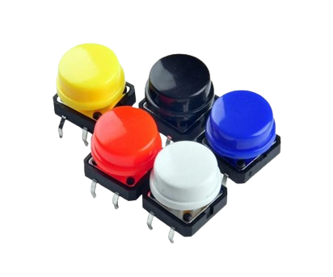
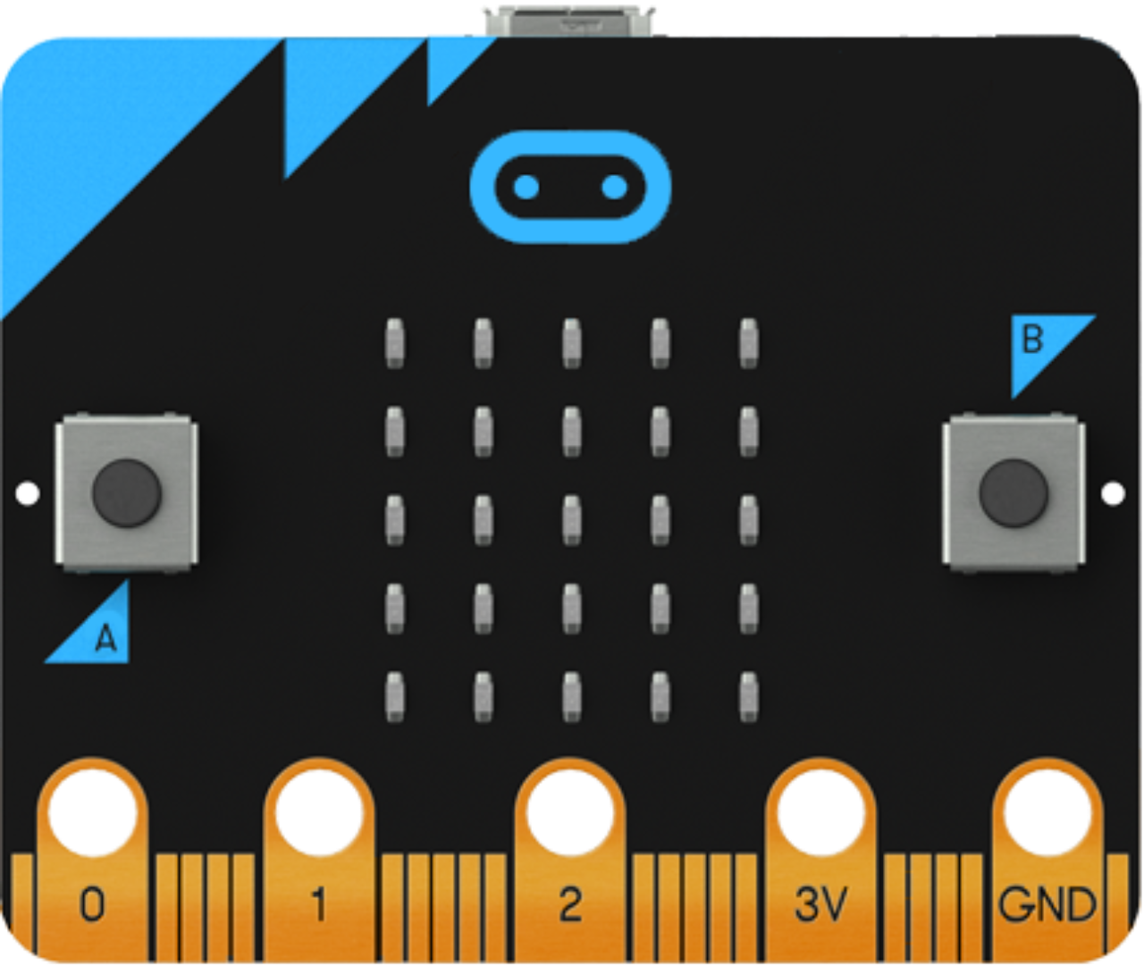
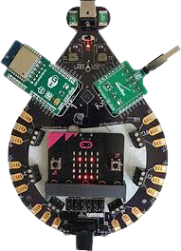
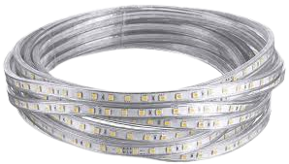
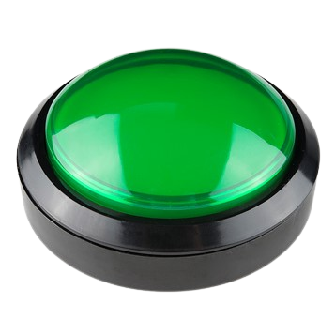
Materials and Resources
Bboard
Micro bits
LED lights
Buttons
Website: https://code.brilliantlabs.ca/

Slide 5
Project’s Flow Charts:
Start
Is button clicked
No
Yes
Participant’s button:
Each button is assigned its own signal number.
Each team has its own signal number.
Send the team’s signal
Send the button’s signal
Received another button’s signal
Yes
No
Stops functioning
End

Slide 6
Start
Project’s Flow Charts:
Received Team A signal
No
Yes
Lights up team’s A color through LED lights.
Received Team B
signal
Bboard:
Indicates which team clicked their buttons first.
Yes
No
Lights up team’s B color through LED lights.
End

Slide 7
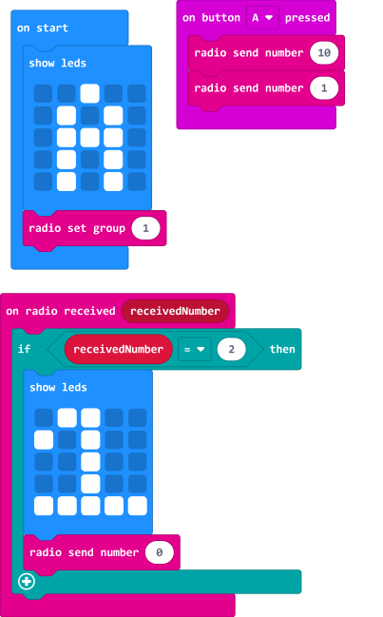
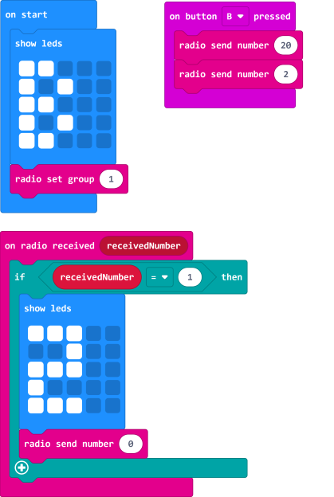
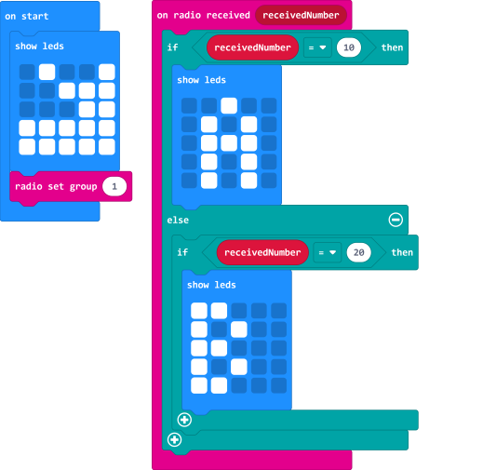
Sample Code testing the radio function:
Team A
Team B
Bboard

